Slide 1
Work Progress
By: Abdur Rehman

Slide 2
Active Learning
Active Learning also known as “Query Learning” and “Optimal Experimental Design” is a field driven from Machine Learning.
The Idea behind this technique is to limit the use of resources in labelling the data points.
In Active learning, an intelligent algorithm can interact a teacher or oracle to label data points in relevance to the desired output as labelling instances
The usage of the scenarios depends on the data type, data query decision type, time limitation.
Active Learning is useful in areas of Speech Recognition, Information Extraction, and Classification and Filtering of data

Slide 3
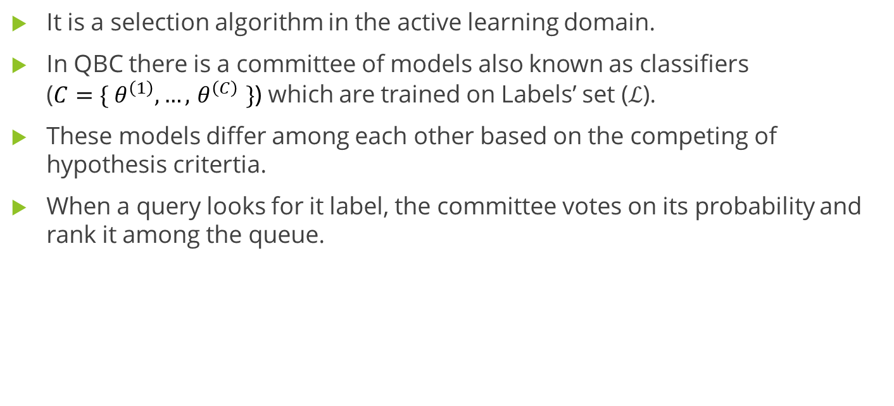
Query By Committee (QBC)
It is a selection algorithm in the active learning domain.
In QBC there is a committee of models also known as classifiers ($C{=\{ θ}^{\left(1\right)},…,{ θ}^{\left(C\right)} \}$) which are trained on Labels’ set ($ℒ$).
These models differ among each other based on the competing of hypothesis critertia.
When a query looks for it label, the committee votes on its probability and rank it among the queue.

Slide 4
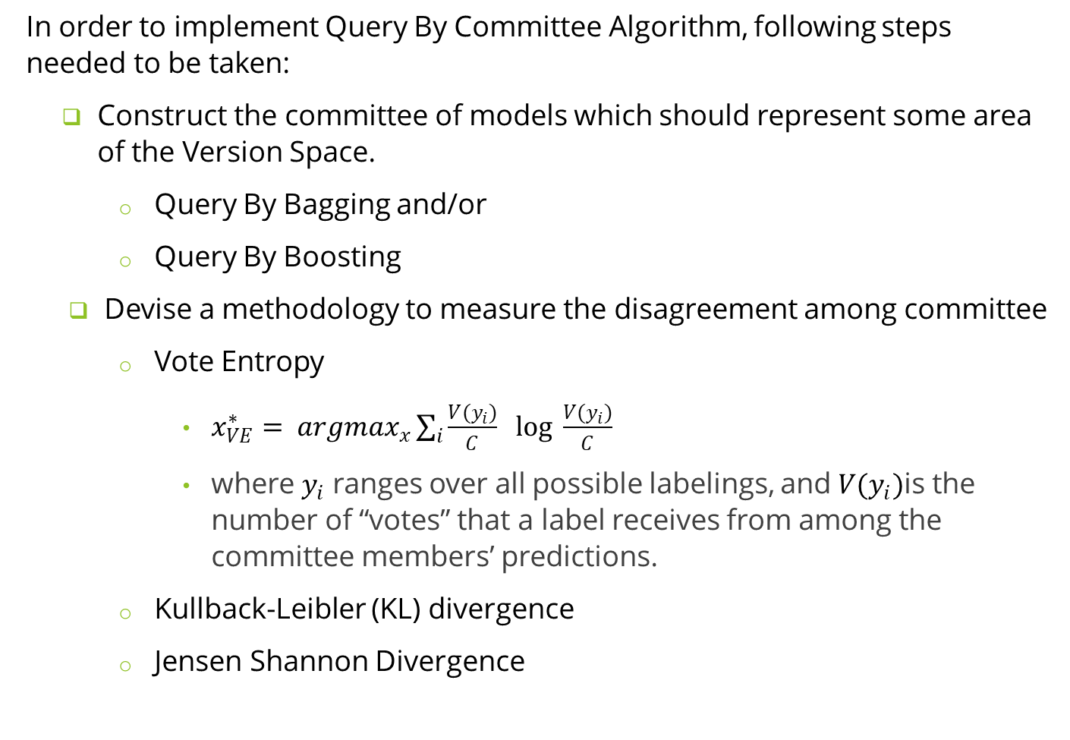
In order to implement Query By Committee Algorithm, following steps needed to be taken:
Construct the committee of models which should represent some area of the Version Space.
Query By Bagging and/or
Query By Boosting
Devise a methodology to measure the disagreement among committee
Vote Entropy
$x_{VE}^{∗}= {argmax}_{x}\sum_{i}^{ }{\frac{V(y_{i})}{C} \log_{ }{\frac{V(y_{i})}{C}}}$
where $y_{i}$ ranges over all possible labelings, and $V(y_{i})$is the number of “votes” that a label receives from among the committee members’ predictions.
Kullback-Leibler (KL) divergence
Jensen Shannon Divergence

Slide 5
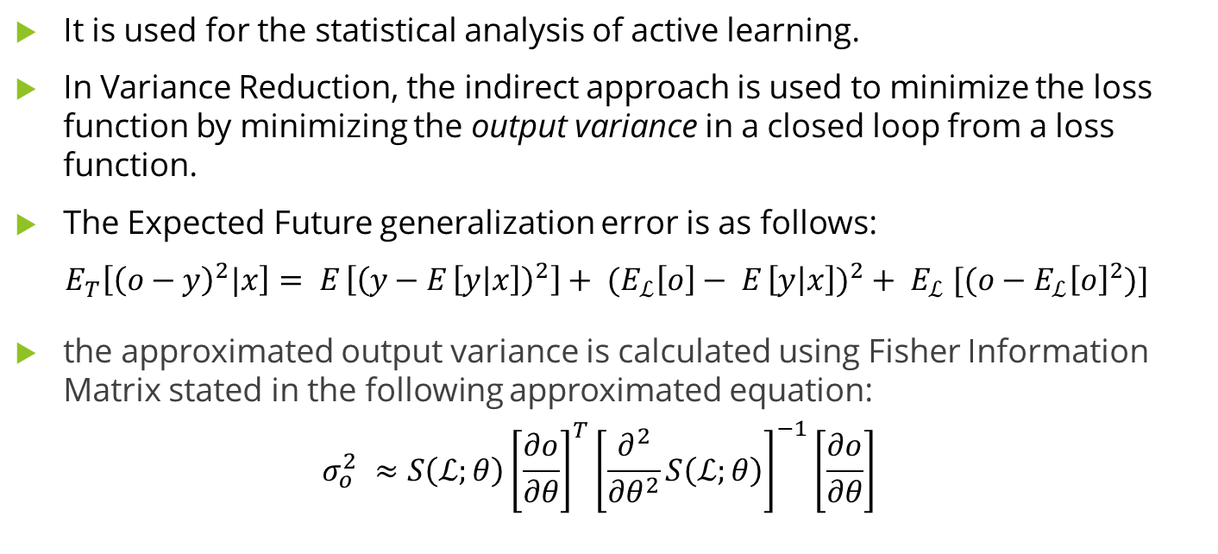
Variance Reduction and Fisher Information Ratio
It is used for the statistical analysis of active learning.
In Variance Reduction, the indirect approach is used to minimize the loss function by minimizing the output variance in a closed loop from a loss function.
The Expected Future generalization error is as follows:
$$E_{T}\left[{\left(o−y\right)}^{2}|x\right]= E_{ }\left[{\left(y−E_{ }\left[y | x\right]\right)}^{2}\right]+ {{(E}_{ℒ}\left[o\right]− E_{ }\left[y | x\right])}^{2}+ E_{ℒ} [(o−{E_{ℒ}\left[o\right]}^{2})]$$
the approximated output variance is calculated using Fisher Information Matrix stated in the following approximated equation:
$$σ_{o}^{2} ≈S\left(ℒ;θ\right){\left[\frac{∂o}{∂θ}\right]}^{T}{\left[\frac{∂^{2}}{∂θ^{2}}S\left(ℒ;θ\right)\right]}^{−1}{\left[\frac{∂o}{∂θ}\right]}^{ }$$

Slide 6
Online vs Offline Neural Network
In the early machine learning processes, the algorithm was mainly driven in the offline format adhering to the static input of data.
In the traditional machine learning process, following methods were taken to complete and update the machine learning algorithm:
Receiving Static Input data file,
Perform Exploratory Data Analysis,
Perform Feature Engineering,
Dividing the data into Training, Testing (for fine tuning the model parameters) and Validation (model selection) sets,
Deployment of the trained model set to the production.
The model is limited to the patterns it has observed in the static input file and cannot adapt to the real-time behavioral changes.

Slide 7
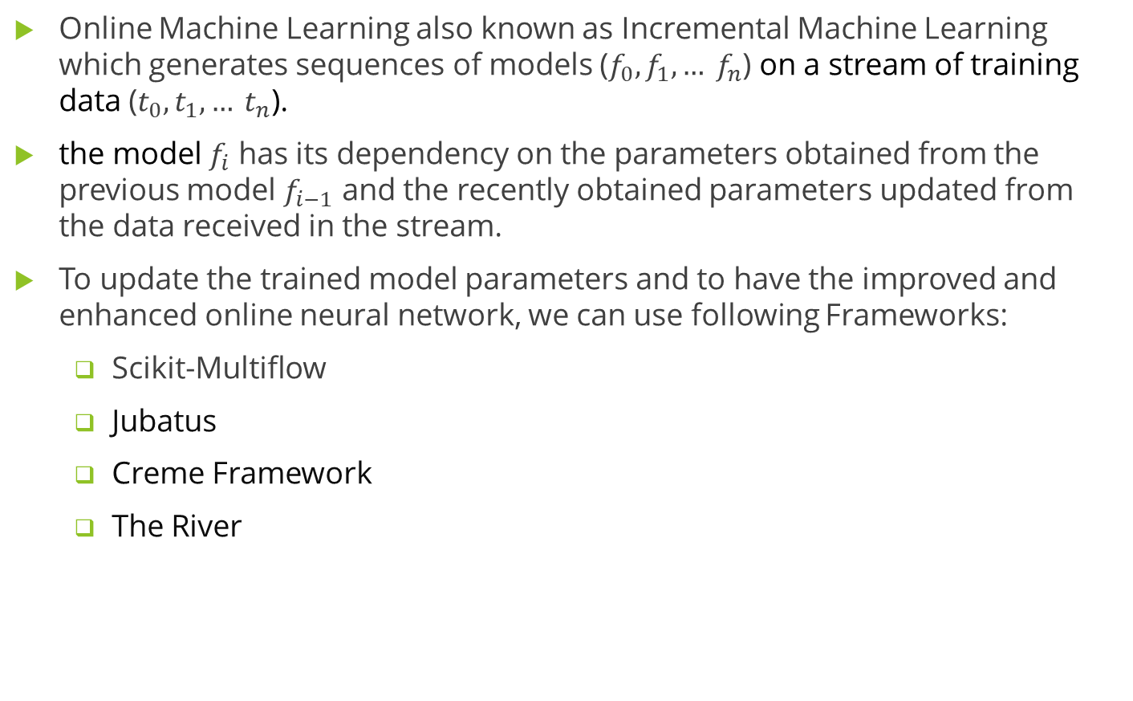
Online Machine Learning also known as Incremental Machine Learning which generates sequences of models ($f_{0}, f_{1}, … f_{n}$) on a stream of training data ($t_{0}, t_{1}, … t_{n}$).
the model $f_{i}$ has its dependency on the parameters obtained from the previous model $f_{i−1}$ and the recently obtained parameters updated from the data received in the stream.
To update the trained model parameters and to have the improved and enhanced online neural network, we can use following Frameworks:
Scikit-Multiflow
Jubatus
Creme Framework
The River

